Slide 1
Fundamentals of IBM Watson Developer Cloud

Slide 2
Objectives
Distinguish cognitive services on WDC
Provide examples of text classification using the NLC
Watson SDKs available as services on Watson Developer Cloud
Watson REST APIs available as services on Watson Developer Cloud
Configure Natural Language Classification
Configure Visual recognition
Personality Insights service

Slide 3
Objectives cont…
Tone Analyzer service
Execute Alchemy Language services
Configure Retrieve and Rank service

Slide 4
Distinguish cognitive services on WDC
Some IBM Watson services work out-of-the-box as they were pre-trained in a specific domain
Other Watson services require training
For pre-trained services, it’s critical to know the adapted domains as they indicate the areas in which the service will perform best

Slide 5
Pre-trained Watson services
Watson Text-to-Speech
Watson Speech-to-text
Language Translation (conversational, news, and patent domains)
Alchemy Language (open-domain)
Watson Visual Insights
Tone Analyzer
Personality Insights (social media domain)

Slide 6
Services requiring training
Natural Language Classifier
Rank part of Retrieve and Rank
Visual recognition (custom models)

Slide 7
Examples of text classification using the NLC
Sentiment analysis
Spam email detection
Customer message routing
Academic paper classification into technical fields of interest
Forum post classification to determine correct posting category
Patient reports for escalation and routing based on symptoms
News article analysis
Investment opportunity ranking
Web page topic analysis

Slide 8
SDKs available as services on WDC
Node SDK
Node.js client library to use the Watson Developer Cloud services, a collection of APIs that use cognitive computing to solve complex problems
Java SDK
Client library to use the IBM Watson Services and AlchemyAPI
iOS SDK
The Watson Swift SDK enables developers to quickly add Watson Cognitive Computing services to their Swift applications.

Slide 9
SDKs available as services on WDC cont…
Unity SDK
Unity, is the development platform for creating 2D and 3D multiplatform games and interactive experiences
Python SDK
Python client library to quickly get started with the various Watson Developer Cloud services.
Android SDK
Android client library to assist with using the Watson Developer Cloud services, a collection of REST APIs and SDKs that use cognitive computing to solve complex problems.

Slide 10
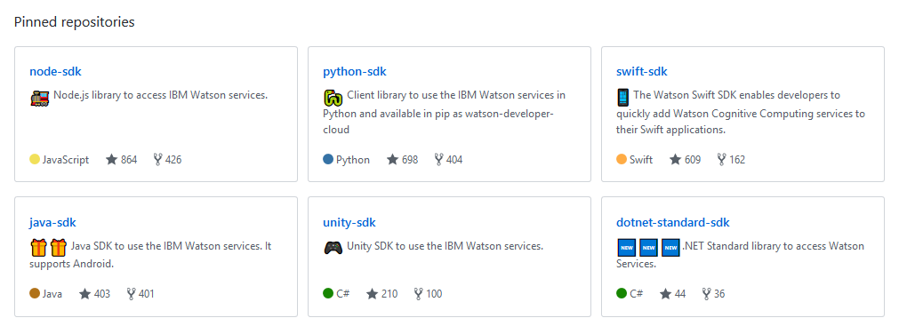
Watson Developer Cloud Github

Slide 11
Watson REST API
Watson Content Analytics REST application programming interfaces (APIs) enable you to create applications to search, explore, and administer collections
REST (REpresentational State Transfer) APIs rely on a stateless, client-server, cacheable communications protocol
REST applications use HTTP requests to post data (create and update), read data (such as running queries), and delete data
REST is a lightweight alternative to mechanisms like RPC (Remote Procedure Calls) and Web Services (such as SOAP and WSDL)

Slide 12
REST APIs
Much like Web Services, a REST service is
Platform-independent
Language-independent
Standards-based (runs on top of HTTP)
Able to be used in the presence of firewalls

Slide 13
Watson REST APIs available on WDC
Identify the Language services on WDC
AlchemyLanguage
Conversation
Document Conversion
Language Translator
Natural Language Classifier
Natural Language Understanding
Personality Insights
Retrieve and Rank
Tone Analyzer

Slide 14
Watson REST APIs available on WDC cont..
Identify the Vision services on WDC
Visual Recognition
Identify the Speech services on WDC
Speech to Text
Text to Speech
Identify the Data Insights services on WDC
AlchemyData News
Discovery
Tradeoff Analytics

Slide 15
Configure Natural Language Classification
Gather sample text from real end users (fake initially if you have to…but not much)
Determine the users intents that capture the actions/needs expressed in the text
Classify your user text into these user intents
Separate your user text into train/test datasets
Train an NLC classifier on your training dataset
Pass the user input to an NLC classifier
Determine the accuracy, precision, and recall of the NLC classifier using your test dataset
Improve the confidence level iteratively through back propagation or other means.

Slide 16
Configure Visual recognition
Describe the process for training a classifier
Explain how to identify images with a specified classifier
Describe the capabilities of Face Detection/Recognition
Describe the capabilities of Natural Scene OCR

Slide 17
Personality Insights service
The Personality Insights service offers a set of core analytics for discovering actionable insights about people and entities
Businesses can use the detailed personality portraits of individual customers for finer-grained customer segmentation and better-quality lead generation
Personality Insights can also be used to help recruiters or university admissions match candidates to companies or universities

Slide 18
Personality Insights service cont..
Input - JSON, or Text or HTML (such as social media, emails, blogs, or other communication) written by one individual
Service output - A tree of cognitive and social characteristics in JSON or CSV format
The service outputs personality characteristics that are divided into three dimensions: the Big 5, Values, and Needs
Recommendation : use Personality Insights with at least 1200 words of input text

Slide 19
Personality Insights service cont..
The service analyzes the content that you send and returns a personality profile for the author of the input. The service infers personality characteristics based on three models:
Big Five personality characteristics represent the most widely used model for generally describing how a person engages with the world. The model includes five primary dimensions:
Agreeableness is a person's tendency to be compassionate and cooperative toward others.
Conscientiousness is a person's tendency to act in an organized or thoughtful way.
Extraversion is a person's tendency to seek stimulation in the company of others.
Emotional Range, also referred to as Neuroticism or Natural Reactions, is the extent to which a person's emotions are sensitive to the person's environment.
Openness is the extent to which a person is open to experiencing a variety of activities.

Slide 20
Personality Insights service cont..
Needs describe which aspects of a product will resonate with a person. The model includes twelve characteristic needs: Excitement, Harmony, Curiosity, Ideal, Closeness, Self-expression, Liberty, Love, Practicality, Stability, Challenge, and Structure
Values describe motivating factors that influence a person's decision making. The model includes five values: Self-transcendence / Helping others, Conservation / Tradition, Hedonism / Taking pleasure in life, Self-enhancement / Achieving success, and Open to change / Excitement.

Slide 21
Tone Analyzer service
The IBM Watson™ Tone Analyzer Service uses linguistic analysis to detect three types of tones from text: emotion, social tendencies, and language style
Emotions identified include things like anger, fear, joy, sadness, and disgust
Identified social tendencies include things from the Big Five personality traits used by some psychologists
These include openness, conscientiousness, extroversion, agreeableness, and emotional range
Identified language styles include confident, analytical, and tentative

Slide 22
Common uses for the Tone Analyzer service
Personal and business communications
Tone Analyzer service can be used to get feedback about their communications, which could improve the effectiveness of the messages and how they are received
Message resonance
optimize the tones in your communication to increase the impact on your audience
Digital Virtual Agent for customer care
If a human client is interacting with an automated digital agent, and the client is agitated or angry, it is likely reflected in the choice of words they use to explain their problem
An automated agent could use the Tone Analyzer Service to detect those tones, and be programmed to respond appropriately to them

Slide 23
Common uses for the Tone Analyzer service cont..
Self-branding
Bloggers and journalists could use the Tone Analyzer Service to get feedback on their tone and fine-tune their writing to reflect a specific personality or style
Input for tone analyser
Any Text
Service output
JSON that provides a hierarchical representation of the analysis of the terms in the input message

Slide 24
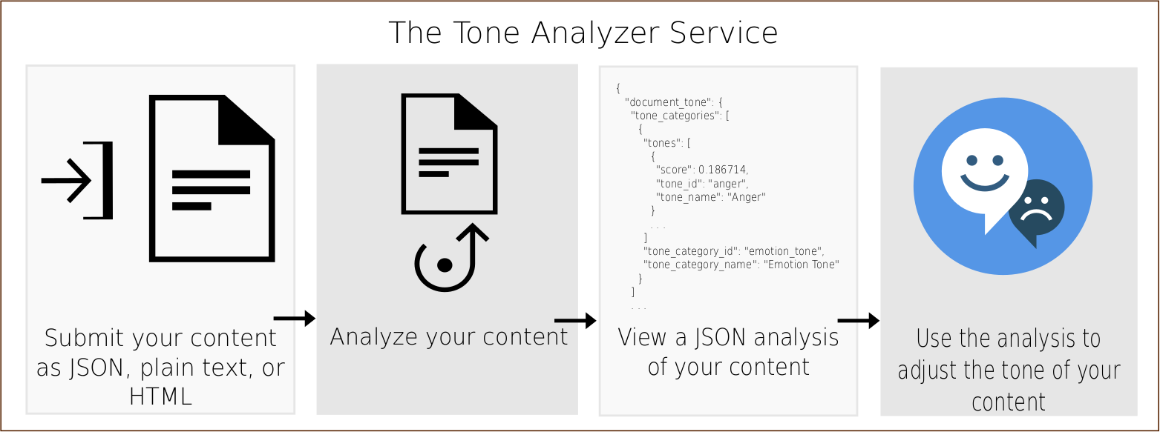
Basic flow of the Tone Analyzer service

Slide 25
Types of Tones
Emotion Tone
Emotion tone now has 5 different emotional sub-tones: anger, fear, joy, sadness, and disgust
The previous, experimental version was only grouped into three emotion categories: negative, cheerful, and anger
Based on the feedback from users, however, we have expanded the set of detectable emotions reflected in text

Slide 26
Types of Tones cont..
Social Tone - Tone Analyzer currently infers five different social tones
Openness - Openness is the extent to which the presented text demonstrates openness to experience a variety of activities
Conscientiousness- Conscientiousness is a tendency to act in an organized or thoughtful way as expressed in the input text
Extraversion - Extraversion is a tendency to seek stimulation in the company of others
Agreeableness - Agreeableness is a tendency, expressed in writing, to be compassionate and cooperative towards others
Emotional range - Emotional range is the extent to which a person’s emotion is sensitive to the environment

Slide 27
Types of Tones cont..
Language Tone
Language tone, formerly known as writing tone, provides feedback on how analytical, confident and tentative one’s writing is
Analytical tone shows a person’s reasoning and analytical attitude about things
Confidence tone indicates the degree of certainty exhibited by an individual towards something
Tentative tone shows the attitude of inhibition

Slide 28
Alchemy Language services
AlchemyLanguage is a collection of APIs that offer text analysis through natural language processing
The AlchemyLanguage APIs can analyze text and help you to understand its sentiment, keywords, entities, high-level concepts and more
Natural language processing APIs are available through AlchemyLanguage to add high-level semantic information

Slide 29
AlchemyAPI's text analysis service functions
Entity Extraction
Sentiment Analysis
Emotion Analysis
Keyword Extraction
Concept Tagging
Relation Extraction
Taxonomy Classification
Author Extraction
Language Detection
Text Extraction
Microformats Parsing
Feed Detection
Linked Data Support

Slide 30
Alchemy Language services usage
input
Any publicly-accessible webpage or posted HTML/text document.
Service output
Extracted meta-data including, entities, sentiment, keywords, concepts, relations, authors, and more, returned in XML, JSON, and RDF formats

Slide 31
AlchemyData News
AlchemyData provides news and blog content enriched with natural language processing to allow for highly targeted search and trend analysis.
AlchemyData News indexes 250k to 300k English language news and blog articles every day with historical search available for the past 60 days
You can query the News API directly with no need to acquire, enrich and store the data yourself - enabling you to go beyond simple keyword-based searches

Slide 32
AlchemyData News usage
input
Build a query with natural language processing to search both the text in indexed content and the concepts that are associated with it.
Service output
News and blog content enriched with our full suite of NLP services. Keywords, Entities, Concepts, Relations, Sentiment, Taxonomy

Slide 33
Retrieve and Rank service
This service helps users find the most relevant information for their query
It uses the combination of search and machine learning algorithms to detect "signals" in the data
Built on top of Apache Solr, developers load their data into the service, trains a machine learning model based on known relevant results, then leverage this model to provide improved results to their end users based on their question or query

Slide 34
Retrieve and Rank service cont…
Input
User questions and queries
Service output
Indexed documents for retrieval Machine learning model (Rank) Service Runtime: A list of relevant documents and metadata

Slide 35
IBM Watson™ Retrieve and Rank service
combines two information retrieval components in a single service:
the power of Apache Solr and
sophisticated machine learning capability
This combination provides users with more relevant results by automatically reranking them by using these machine learning algorithms.

Slide 36
Primary uses of RR
The core users of the Retrieve and Rank service are customer-facing professionals, such as support staff, contact center agents, field technicians, and other professionals
These users must find relevant results quickly from large numbers of documents:
Customer support: Find quick answers for customers from your growing set of answer documents
Field technicians: Resolve technical issues onsite
Professional services: Find the right people with the right skills for key engagements

Slide 37
Benefits of RR
The Retrieve and Rank service can improve information retrieval as compared to standard results
The ranker models take advantage of rich data in your documents to provide more relevant answers to queries
You benefit from new features developed both by the open source community and from advanced information retrieval techniques that are built by the Watson algorithm teams
Each Solr cluster and ranker is highly available in the Bluemix environment.
The scalable IBM infrastructure removes the need for you to staff your own highly available data center

